Slide 1
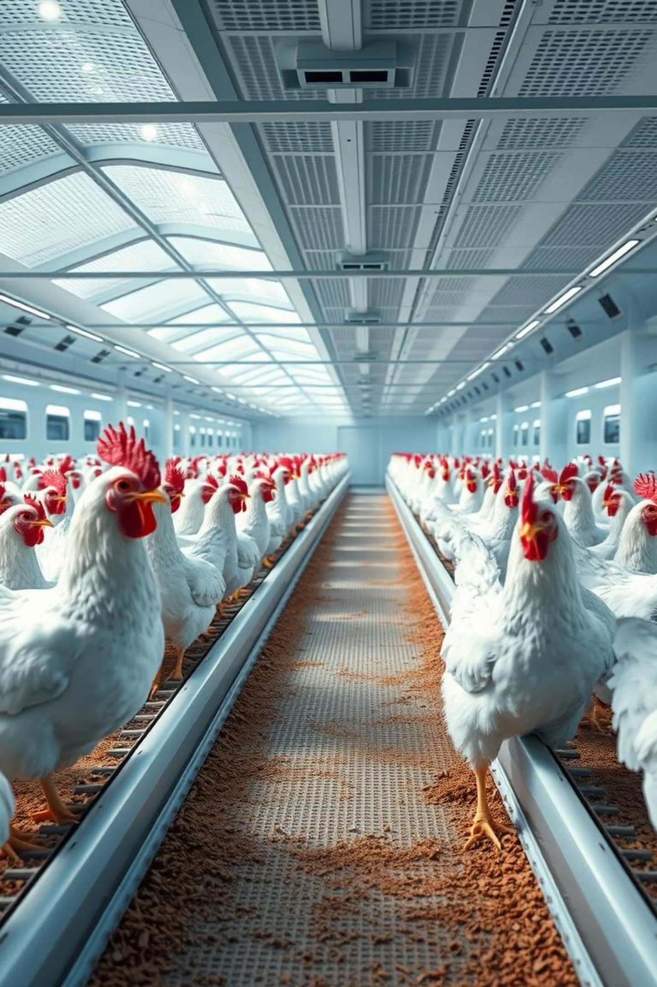
Transfer Learning-Based Classification of Poultry Diseases for Enhanced Health Management
College Name: Seshadri Rao Gudlavalleru Engineering College
Team Members:
B Navya Sai Sree
Anagani Siva Babu
Anand Kumar Chelli
Ampolu Triveni

Slide 2
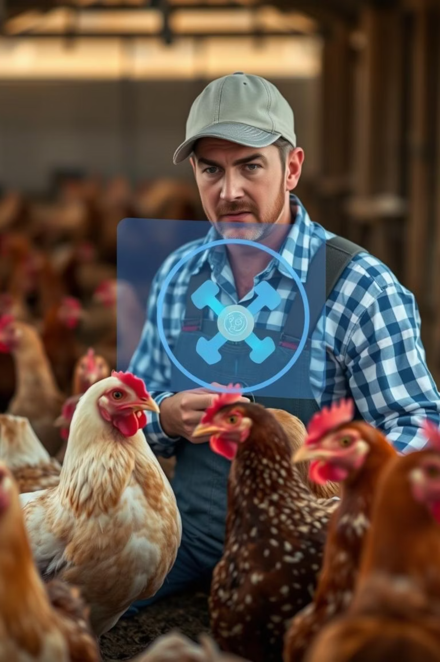
Brainstorming & Ideation
Objective
Problem Statement
Identify core problems faced by poultry farmers and develop an AI-powered solution using transfer learning to detect poultry diseases accurately and efficiently.
Poultry farmers lack access to veterinary professionals and technical knowledge for early diagnosis, leading to high mortality rates and economic losses.
Proposed Solution
Develop an image classification system using VGG16 and transfer learning to detect diseases from poultry images, deployed as an accessible web-based tool.

Slide 3
Target Users & Expected Impact
Target Users
Expected Impact
Poultry Farmers
Enables early detection of poultry diseases using AI
Veterinary Officers
Reduces dependency on in-person veterinary visits
Agriculture and Livestock Researchers
Lowers bird mortality rate
Rural Development NGOs
Enhances economic stability for poultry operations

Slide 4




Requirement Analysis
Technical Requirements
Functional Requirements
Python, TensorFlow/Keras, NumPy/Pandas, Matplotlib/Seaborn, OpenCV, Flask/Django, Google Colab, Jupyter Notebook, Hyperband, HTML/CSS.
Image classification (VGG16, VGG19, ResNet50), preprocessing, model training/evaluation, hyperparameter tuning, confusion matrix, and a web UI for image input and prediction display.
Constraints
Limited dataset, restricted to free-tier GPUs, manual labeling, and backend/frontend integration challenges.

Slide 5
Project Design
System Architecture
1.User
(Web UI)
2.Upload Image
(HTML Form)
3.Flask Backend
(Python)
4.Preprocessing Image
7.Display
Result on UI
6.Prediction Output
(class/label)
5.Trained CNN Model
(Keras)

Slide 6
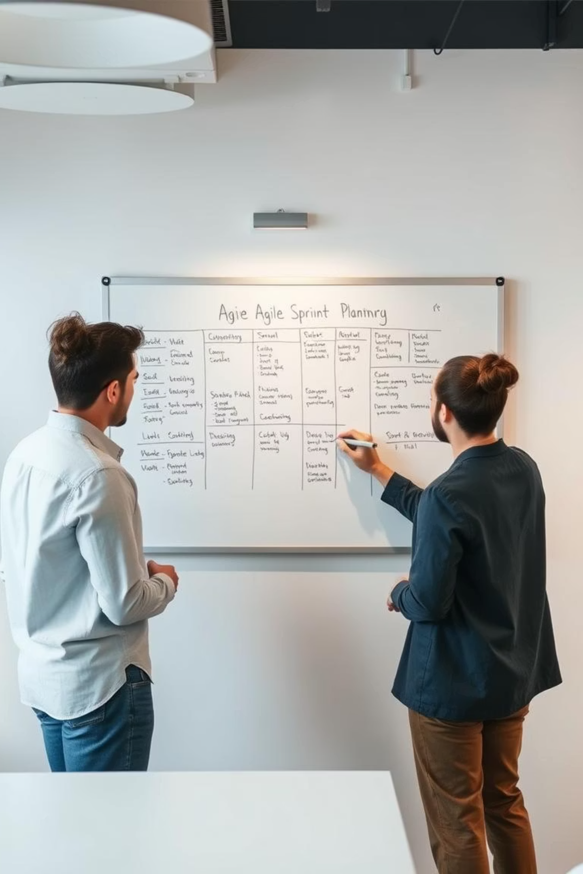
Project Planning (Agile Methodology)
1
Sprint Planning
Sprint 1: Data collection & preprocessing. Sprint 2: Model training & evaluation. Sprint 3: Web integration with Flask. Sprint 4: UI development and testing.
2
Task Allocation
Team Member A: Data handling, OpenCV. Team Member B: Model development. Team Member C: Flask API. Team Member D: UI/UX design.
3
Timeline & Milestones
Weeks 1-2: Dataset preparation. Weeks 3-4: Model training. Week 5: Backend. Week 6: Frontend & integration. Week 7: Testing. Week 8: Deployment & presentation.

Slide 7
Development & Testing
Project Development
Functional & Performance Testing
Objective: Integrate trained AI model with a fully functional web interface. Technology Stack: Python, HTML, CSS, Flask, TensorFlow, Keras, OpenCV, PIL, Google Colab, GitHub, VS Code, Render/Heroku. Workflow: Model training, frontend, backend, testing.
Objective: Ensure reliability, accuracy, and robustness. Test Cases: Valid/Invalid/Large Image, No Input, Unseen Class. Bug Fixes: MIME type checks, image size reduction, dependency updates, load_model() fix. Final Validation: Accurate classification, functional web app, optimized and robust.

Slide 8
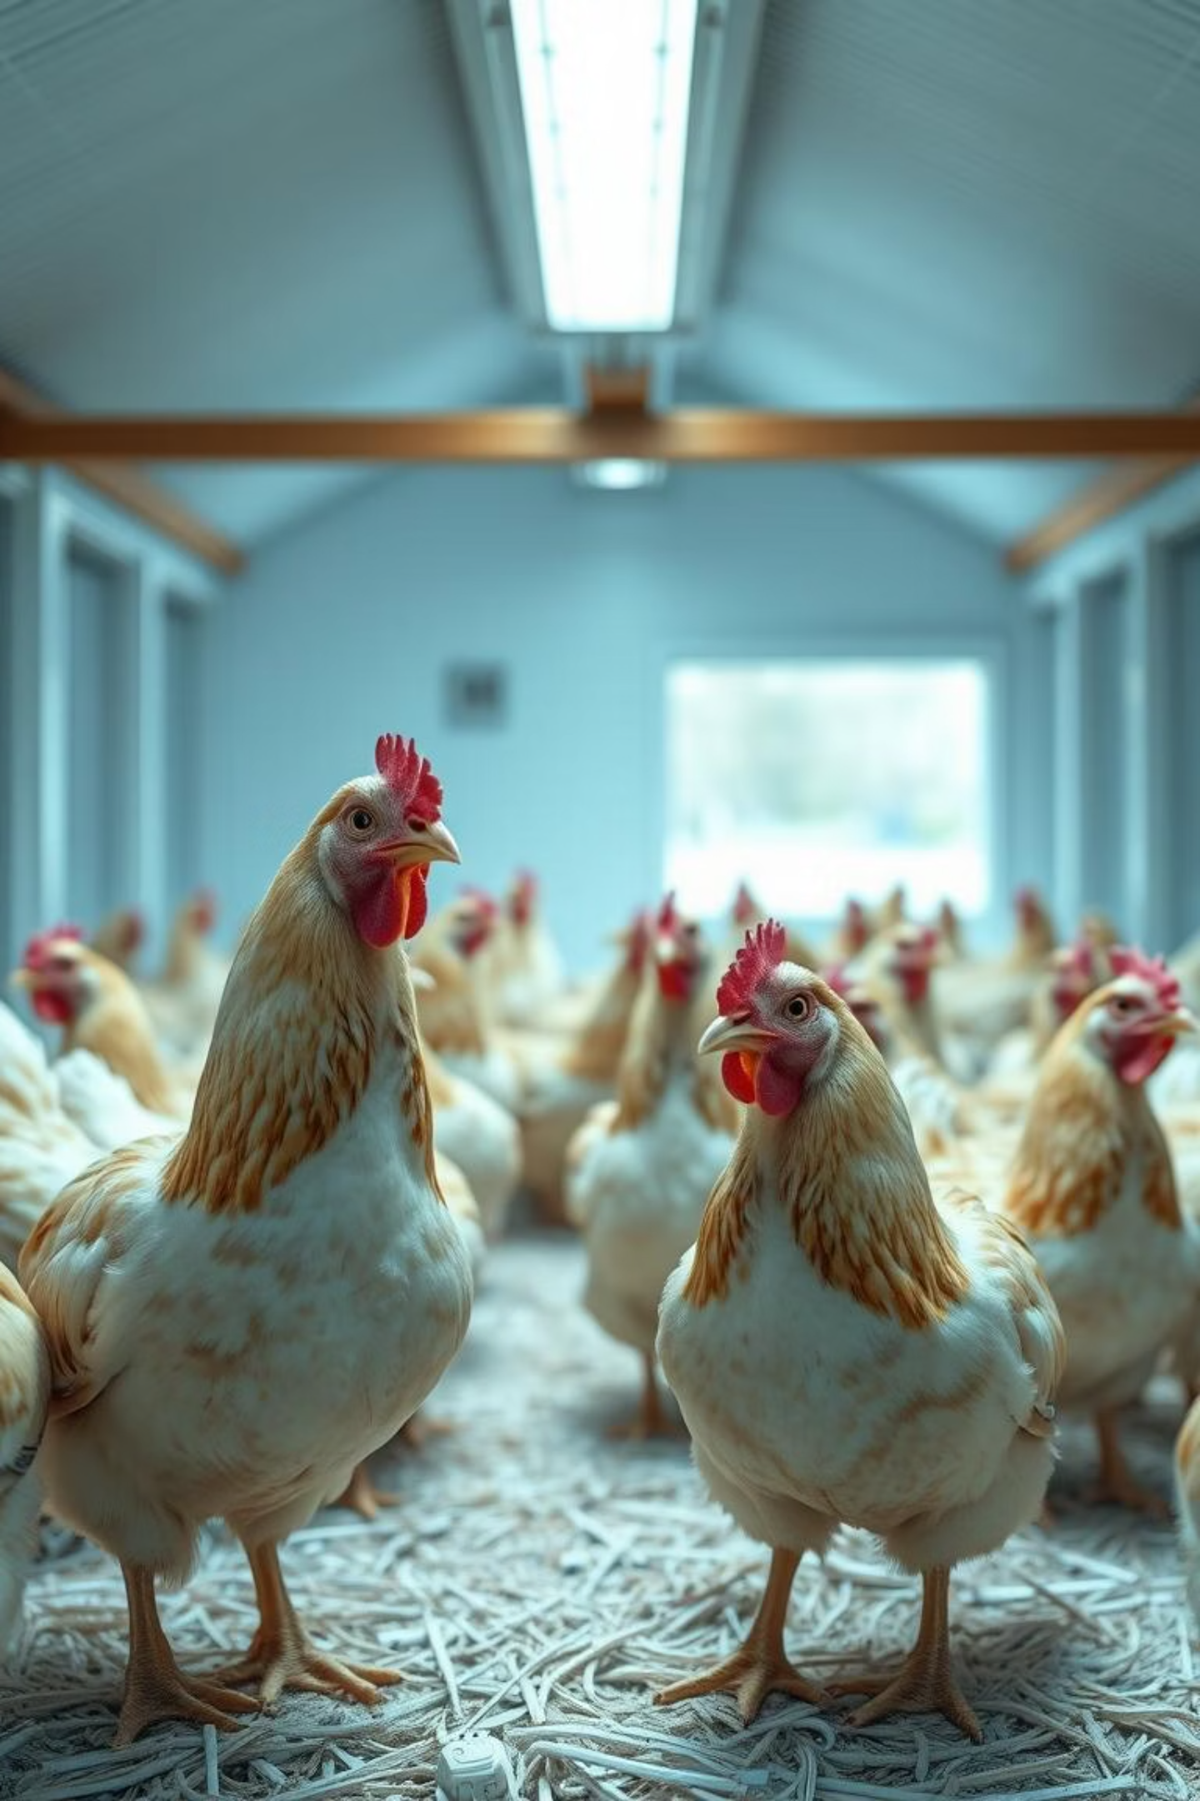
Conclusion & Future Impact
This project delivers an innovative AI solution for poultry disease management, leveraging transfer learning to reduce human intervention and increase diagnostic accuracy. It is scalable and adaptable to other livestock domains.
This system directly contributes to global food safety and economic sustainability by enabling early and accurate disease detection, ultimately improving poultry health and farm profitability.

